Slide 1
AUDIT
OF
ELECTRICAL SYSTEMS
IN
LHB COACHES

Slide 2
Due to occurrence of various fire incidents across Indian Railways, Railway Board advised RCF to conduct a fire safety audit of electrical circuits, cabling and harnessing, manufacturing practices and testing methods in LHB coaches.
Safety Audit of 13 variants of LHB coaches (FAC, 2AC, 3AC, AB LGS, AB LSCN, AB LSLRD, AB pantry car, LWSCZ, LWSCZAC, Double Decker AC, USBRL 3T, AC-CC, LHB Power car) was conducted by M/s RITES.

Slide 3
SCOPE

Slide 4
1. Electrical Circuit design
Specification, Drawings, BOM/BOQ
Complete audit of Electrical scheme in each of the Coach variants
2. Cabling and Harnessing
Size of cables including routing in the coach
Grade/specification of the cables employed
3. Manufacturing practices
Clamping of cables and conduits
Size mismatch between conduits
4. Testing methods of electrical circuits and its components

Slide 5
FINDINGS

Slide 6
Design (Specification, Drawings and BOM/BOQ)
SN | Finding | Action Taken
1 | Few MPCBs and their current settings were not adequately matched with the maximum operating load current of the connected equipment. | Ratings and setting of MPCBs for Condenser, Compressor, Blower, WRA were modified.
2 | Mismatch in Nomenclature/ Component serial number and placement of components in drawing | Corrected in revised spec of SBC
3 | Nominal MCB rating found overrated as compared to load | 3 Amp MCB has been standardized by RDSO in place of 6 Amp for light circuits
4 | Excessive looping of 415V power cables inside SBC and Congested internal wiring | Additional connectors provided in SBC for Looping Arrangement of MPCBs
5 | Sharp metallic edges in cable path without protective sleeves | Manufacturers advised to take care the quality.
6 | Rodent entry from the back side of SBC | Provision of perforated sheet for rodent proofing in SBC drawing

Slide 7
MANUFACTURING & QUALITY
SN | Finding | Action Taken
1 | Positive and negative cables passing through single conduit | Segregation DC positive & negative circuits. (110V DC)
2 | Improper Cable Crimping at some locations | Training imparted to technicians as per issued WI
3 | Conduit fixing clamp are not fully tightened | Modified clamps are provided
4 | Excess Cable Length and Improper Dressing | Length optimization done in Harness spec
5 | Missing / Improper Ferrule Identification | Revised harness spec issued
6 | Mismatch of Conduit Size in U/F | PMA conduits sizes matched and joints eliminated
7 | Deficiencies in Cable Entry Protection | Provision of EPDM module for cable entry
8 | Improper routing of cables and conduit in U/F | Modified routing and securing of conduits in U/F
9 | Battery support not proper | Clamp modified for 4 module batteries

Slide 8
Testing, Inspection, Process & Documentation
1. WI issued
HV, IR and Continuity test
Illumination test
Stage wise inspections
Torque marking of fasteners
Temperature rise test of LED luminaries
Conduiting of cables to RMPU
2. Revised Specification for cable harness
Optimization of cable length
Earthing cable added for all electrical circuits
Provision of 1 amp glass fuse as a primary protection
Segregation DC positive & negative circuits. (110V DC)

Slide 9
Summary of Compliance
Total 706 observations were noticed in 13 coach variants
Design documents issued: 80 Drawings, 10 WIs and 7 Check sheets
S. No. | Coach Type | Observations
1 | LHB AC 2Tier | 71
2 | LHB AC 3Tier | 79
3 | LHB FAC | 73
4 | AB LSCN | 72
5 | AB LGS | 65
6 | AB LSLRD | 50
7 | AB Pantry | 43
8 | LHB Double Decker | 45
9 | LHB EXCC | 42
10 | LHB PC | 34
11 | LHB AC CC | 54
12 | NAC CC | 45
13 | USBRL 3Tier | 33
 | TOTAL | 706

Slide 10
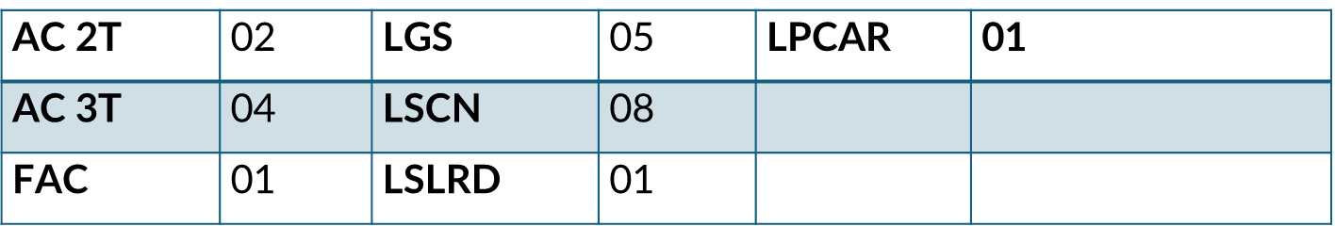
MODEL RAKE
Each Model rake consists of 22 coaches of 07 types of variants as follows. Inspection of 44 coaches to be done at Stage 3, Stage 9 and Final Testing stage of coach manufacturing.
Variants per rake:

Slide 11
IMPROVEMENTS

Slide 12
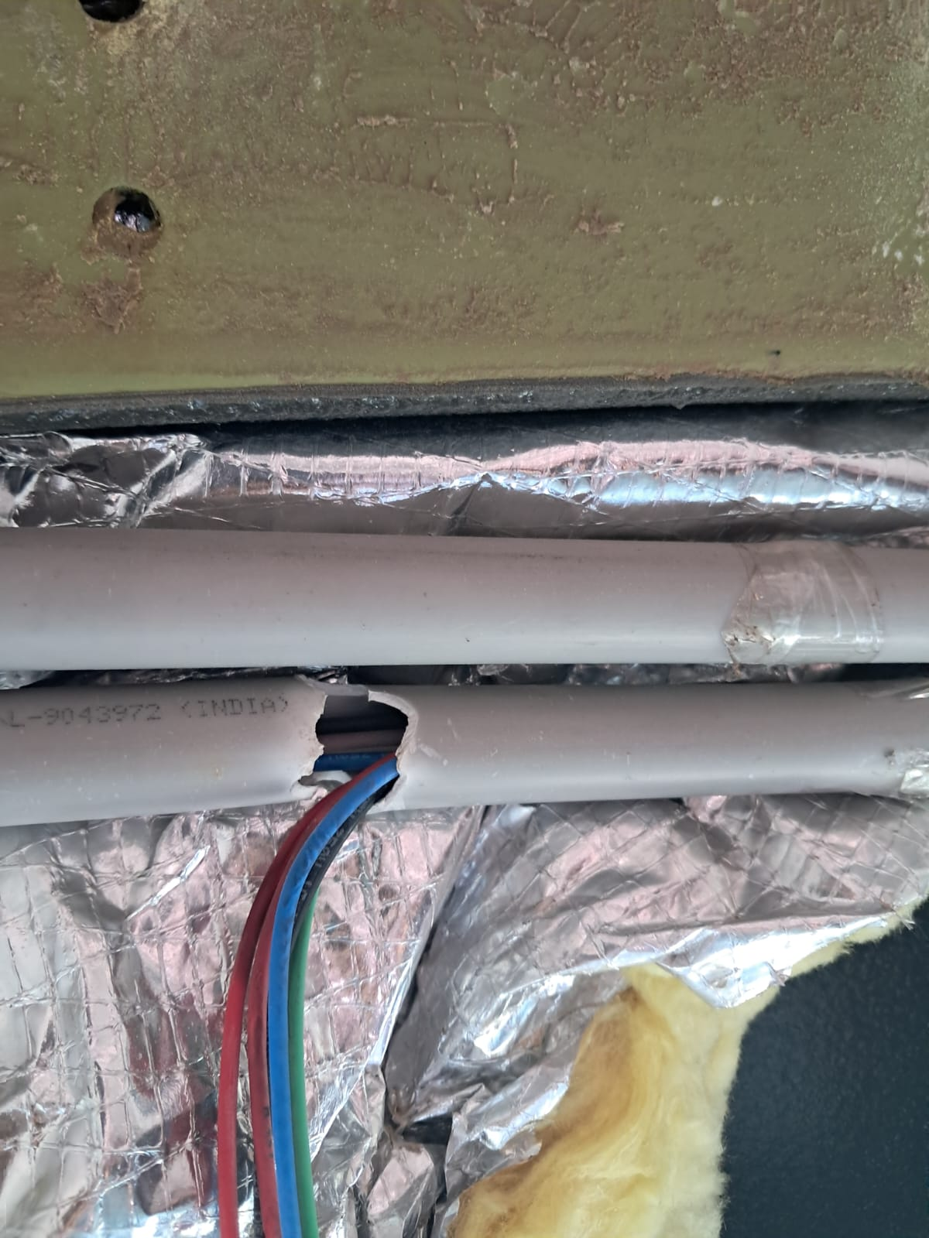
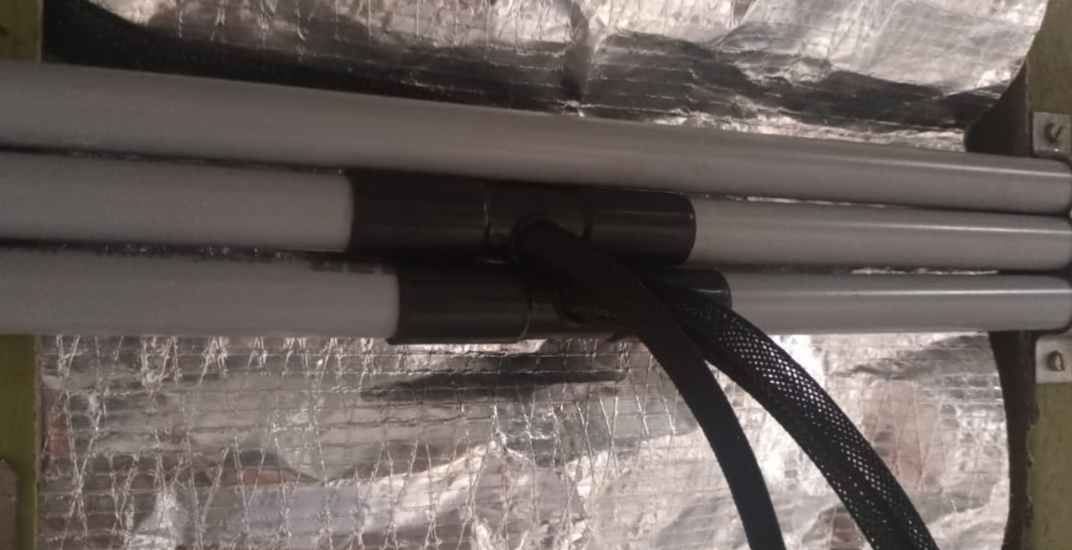
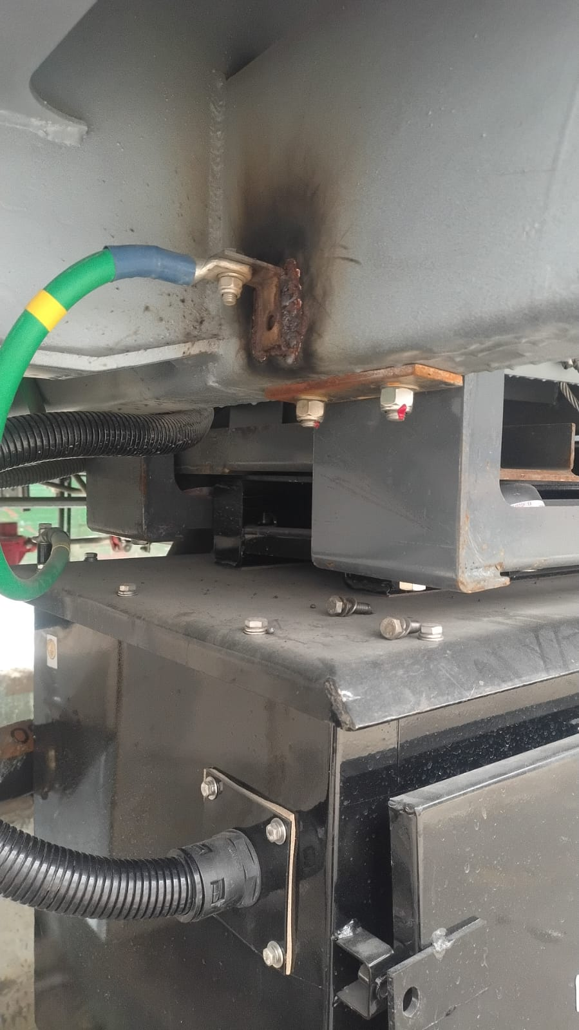
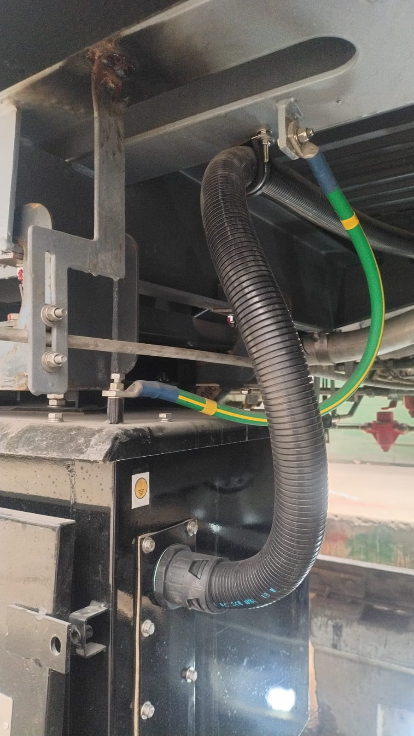
Issue | Modification done
4-way socketed couplers for jumper wiring
Correct size of earthing lug of 9 KVA Transformer

Slide 13
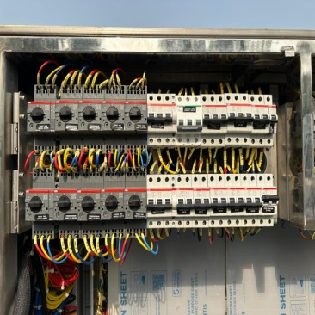
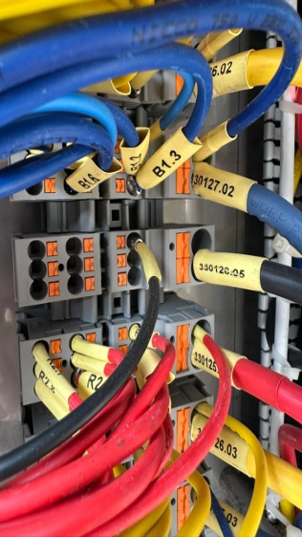
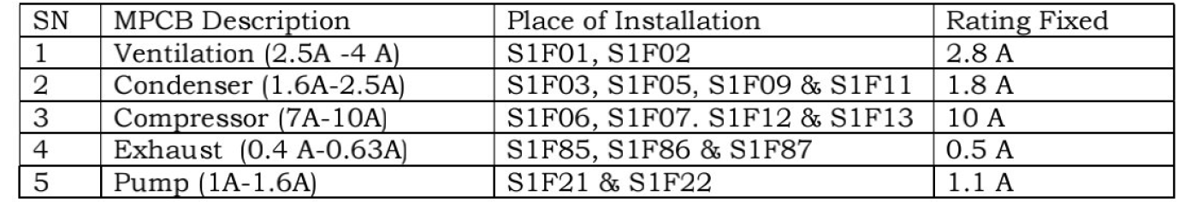
Modified Switch Board Cabinet (SBC) | MPCBs (9 Nos.) replaced with revised rating with push-in type instead of screw type terminals. Elimination of looping in MPCB circuits in SBC Proper dressing of cables with cable ties.
Revised MPCB Ratings

Slide 14
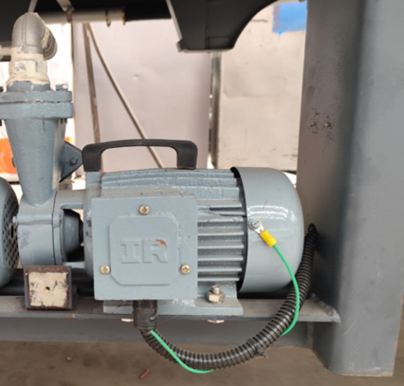
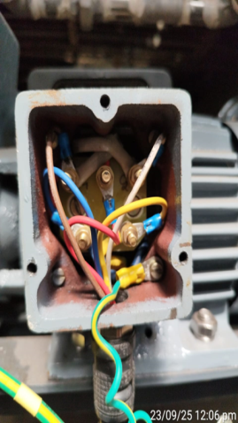




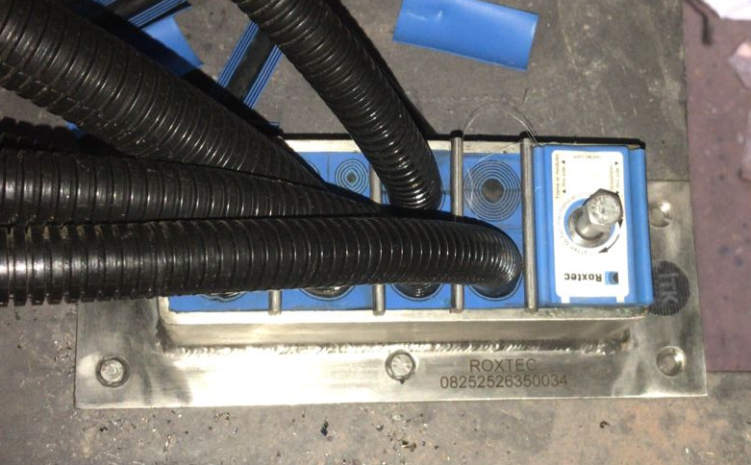
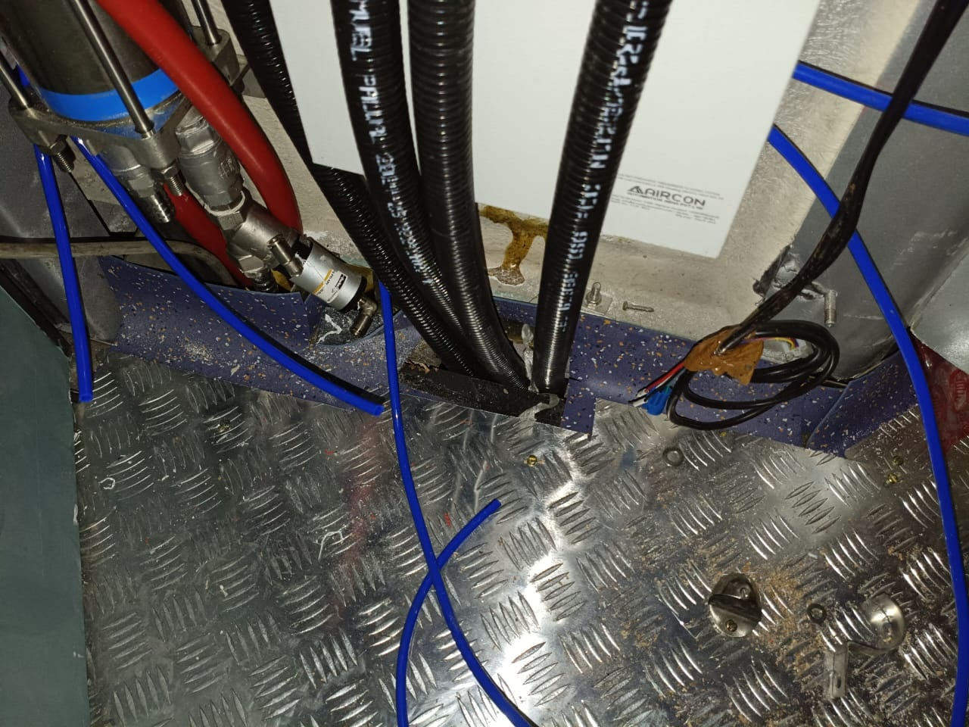
Enhanced Earthing & Clamps
EPDM Module Provision

Slide 15
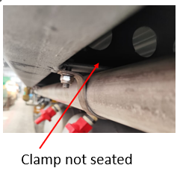
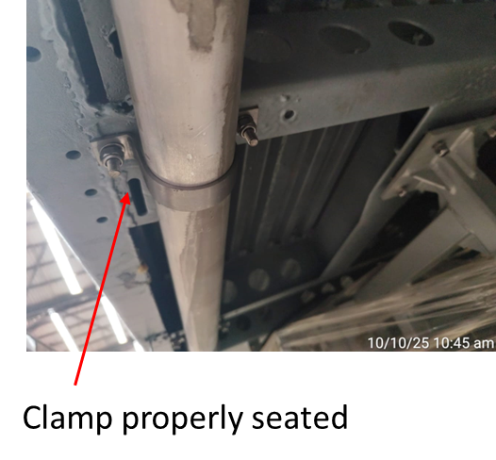
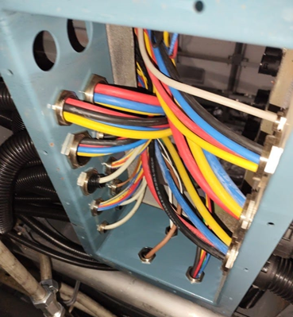
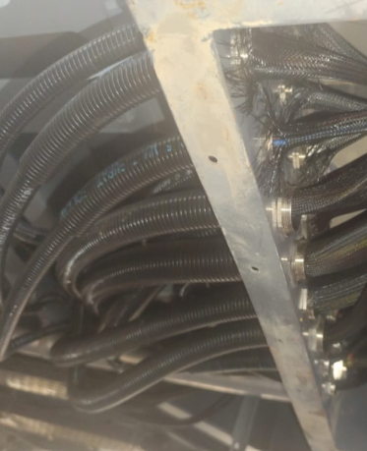
Enhanced Earthing & Clamps
Cable Protection

Slide 16
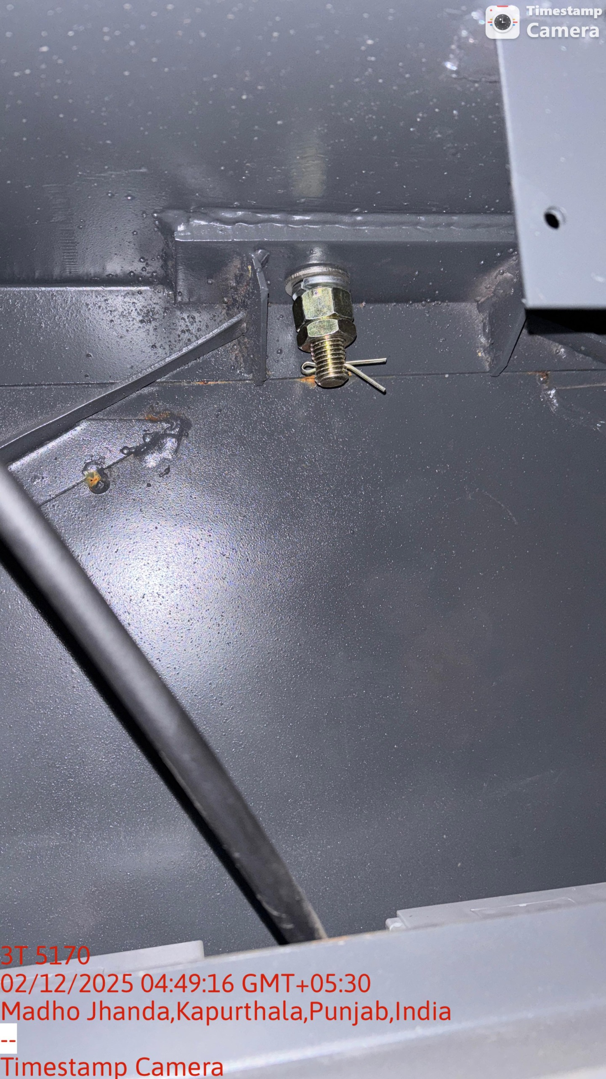
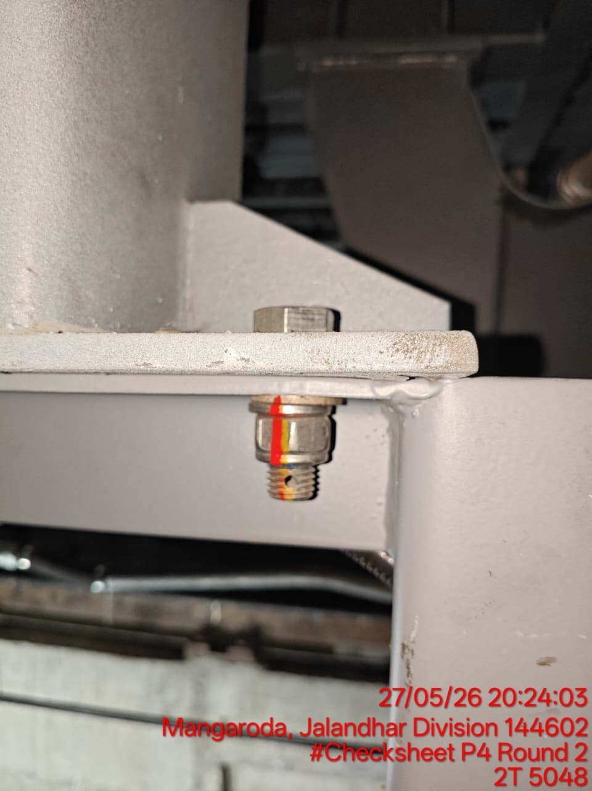
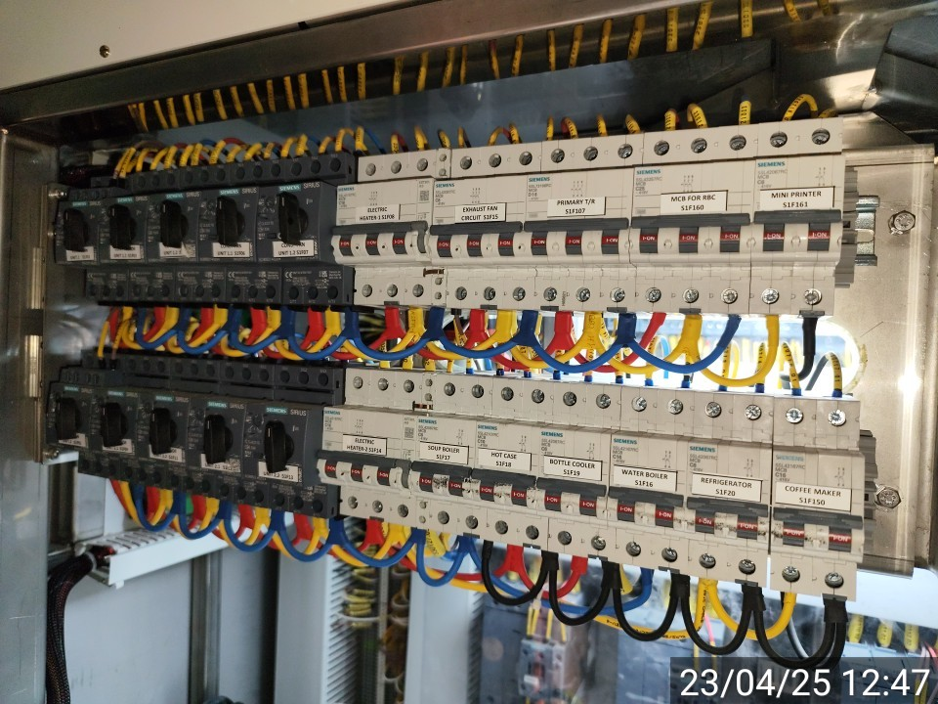
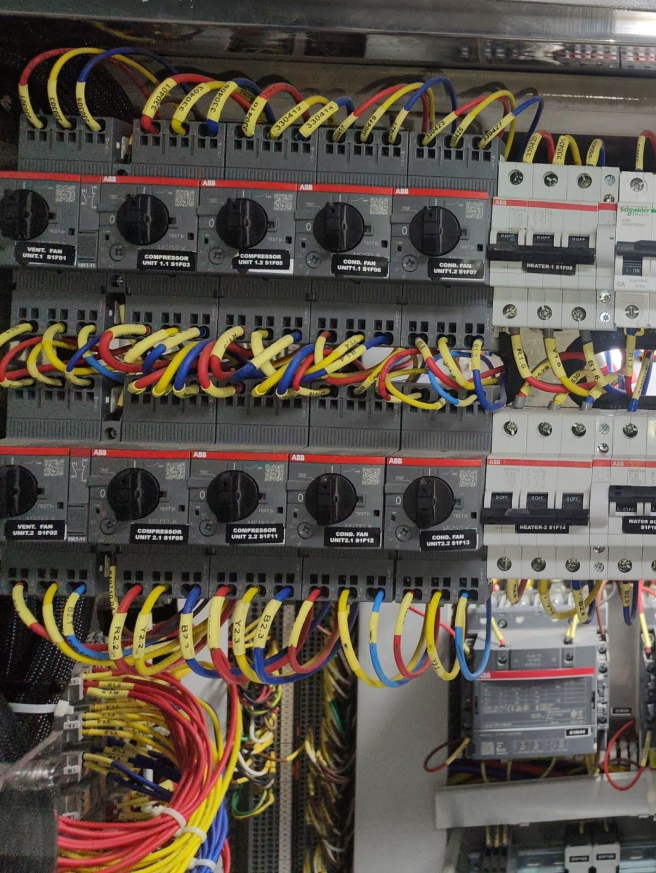
Torque value set and marking | Before torque marking After torque marking
Eliminating Multiple looping at MPCB | Looping arrangement at MPCB’s I/P Single connection Arrangement

Slide 17
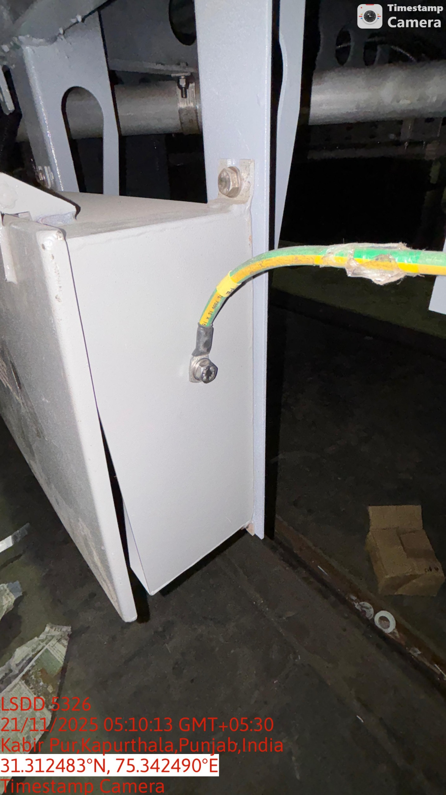
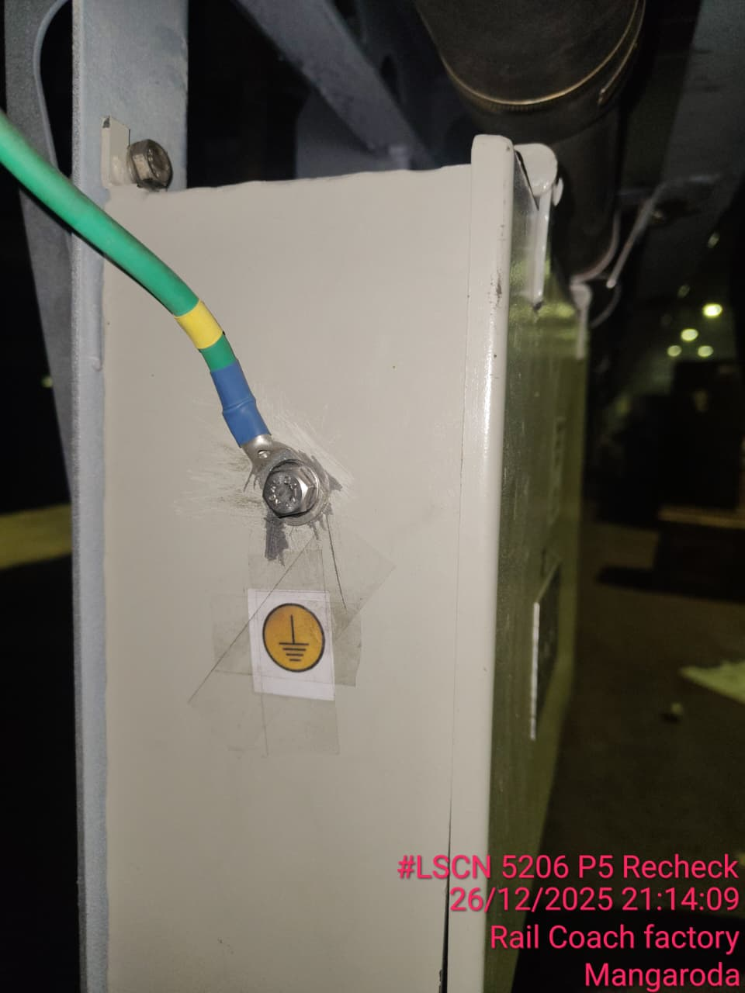
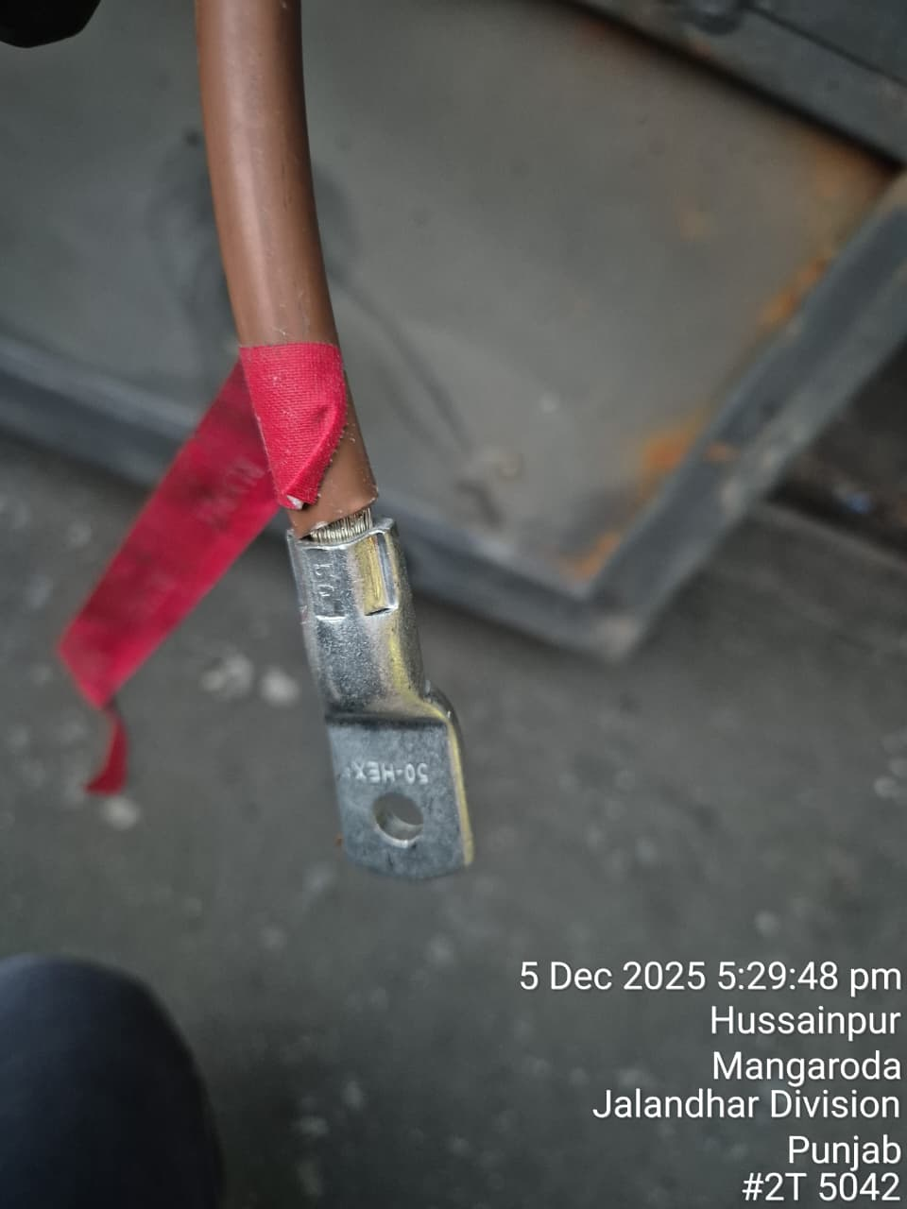
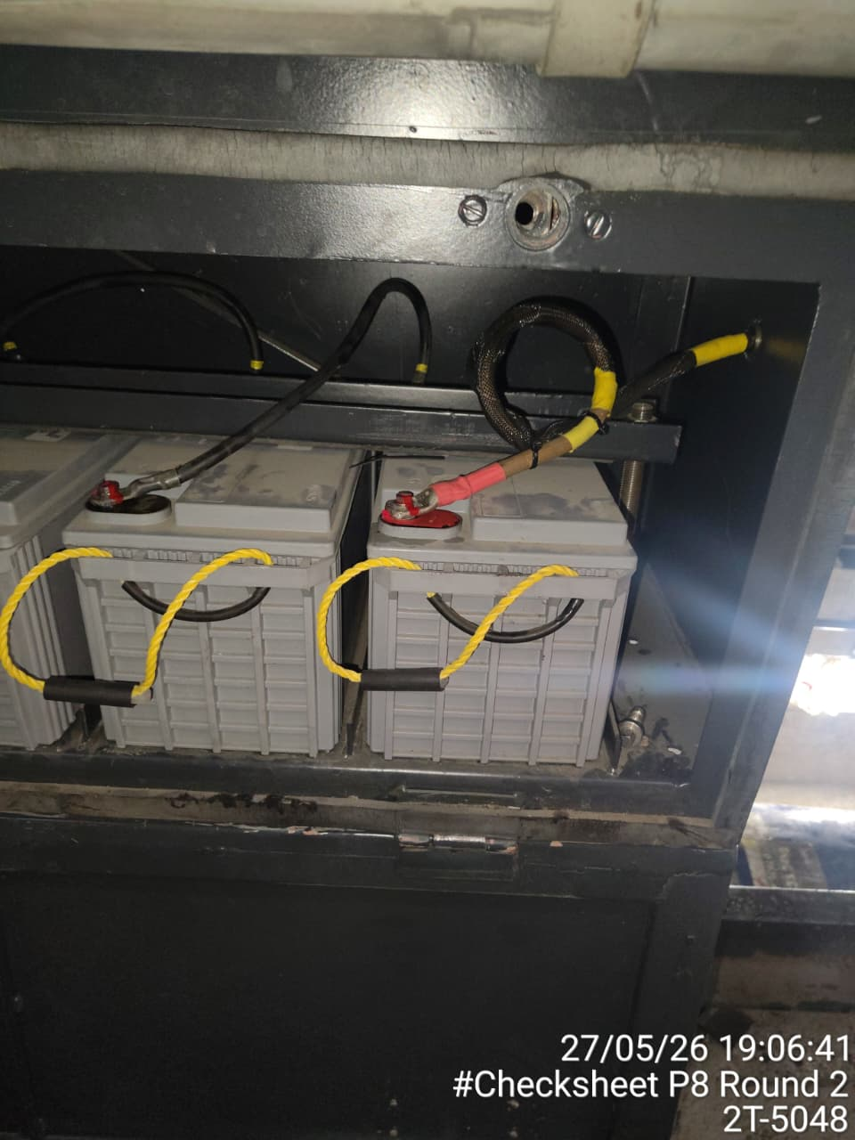
Provision of Earth marking | Before Earth marking After Earth marking
Improvement in Crimping process | Before After

Slide 18
Additional Fire & Safety features - 2 Nos. 3AC
SN | Item
1 | Electrical Modification
 | 110 V DC scheme with 2.5 kVA inverters in u/f
 | Shifting of 415V cables from passenger area to u/f
 | LED as per Revised RDSO
2 | Mechanical Modification
 | Use of metallic conduits for main cable routing
 | Ceramic fire-retardant paint & fire sealants at critical interfaces
 | Fire smoke detection cum suppression system in lavatories
 | FSDS with integrated LHD cable

Slide 19
THANK YOU

